Slide 1
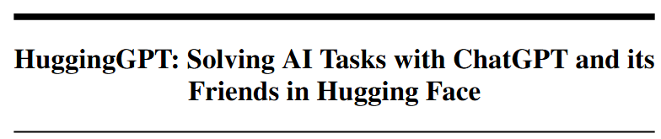
Presenter: 김진용

Slide 2
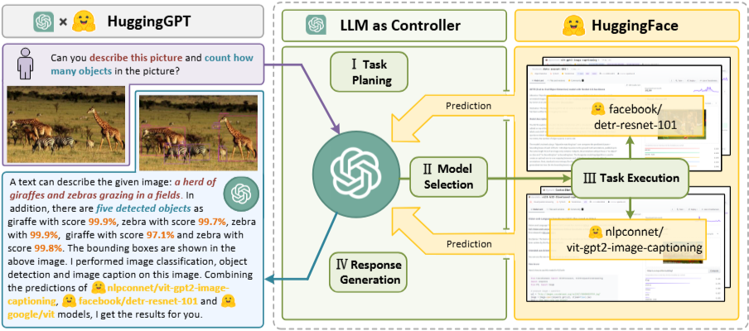
Introduction
LLM Research Topic
In-context learning
Instruction learning
Chain of Thought
Limitation of LLM
Lack the ability to process complex information such as vision and speech.
Real world problems need to be resolved by cooperation of multiple models.
Individual expert models still outperform LLM in the specific field.
Proposed LLM-powered agent : HuggingGPT
Task planning
Model selection
Task execution
Reponse generation
“Language as a generic interface for LLM to collaborate with AI models”

Slide 3
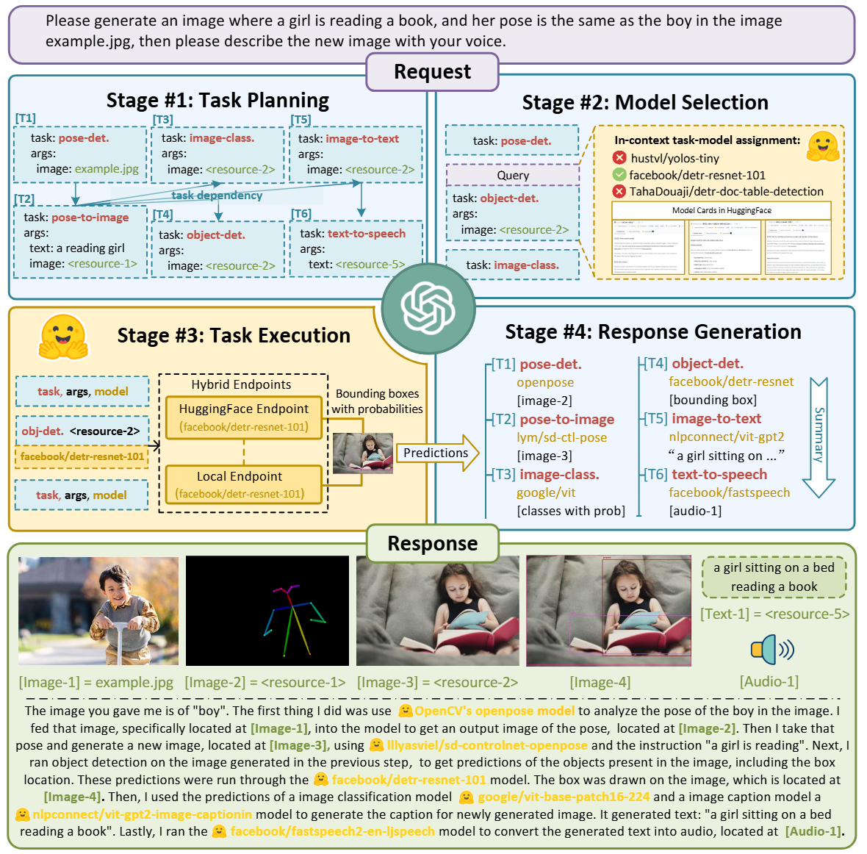
HuggingGPT

Slide 4
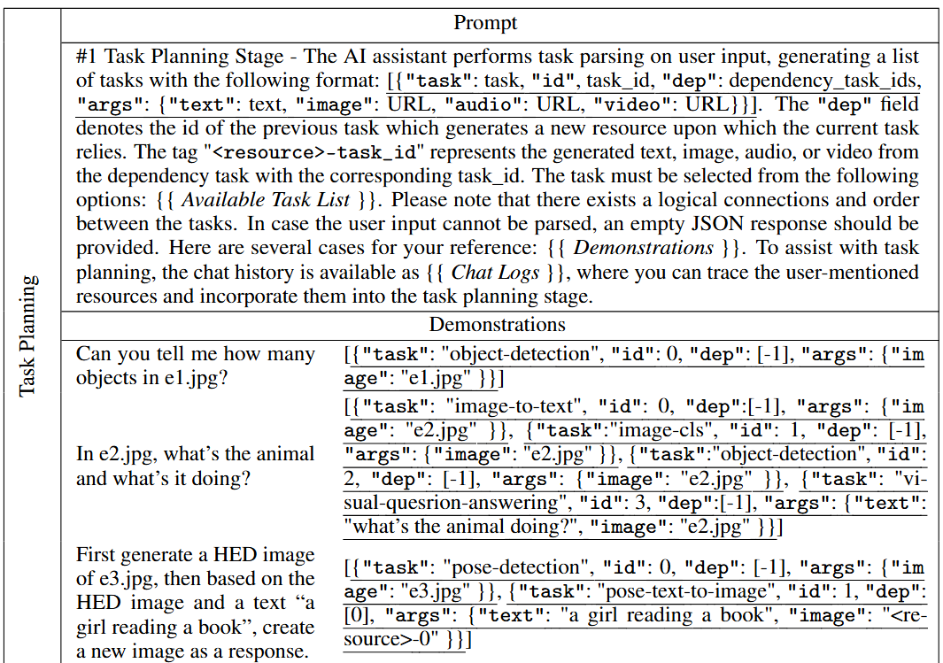
HuggingGPT
Task Planning
Specification-based Instruction
Json format
(“task”, “id”, “ dep”, “args”)
Demonstration-based Parsing
Multiple demonstrations
Multi-turn dialogues

Slide 5
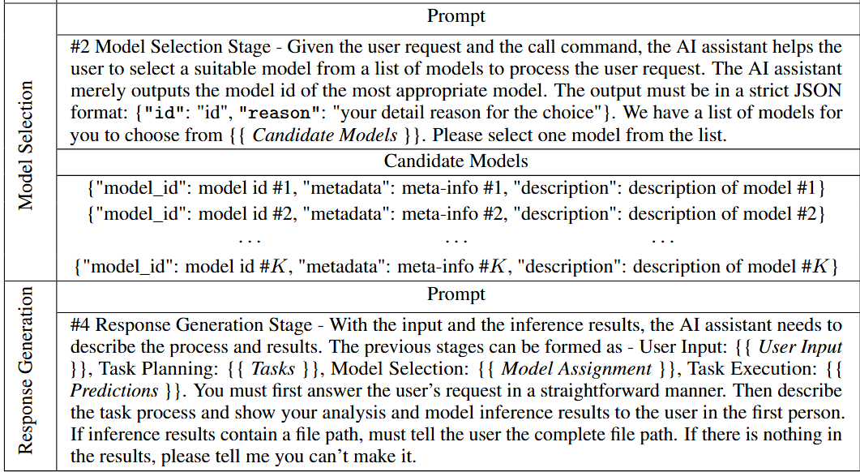
HuggingGPT
Model Selection
Gather the descriptions of expert models from ML community.
In-context Task-model Assignment : filter out models based on their task type and rank them based on the number of downloads on Hugging Face.

Slide 6
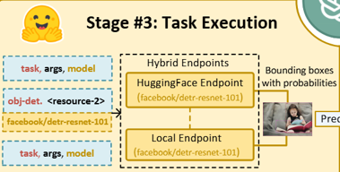
HuggingGPT
Task Execution
Resource Dependency
Prerequisite task <resource>-task-id
To emphasize the issue of resource dependencies.
Hybrid Endpoint in System Deployment
Cloud service(Hugging Face)
Slow but cover many models
Only if the matched model is not deployed locally
Local inference endpoints
Fast but cover fewer models

Slide 7
HuggingGPT
Response Generation
HuggingGPT integrates all the information from the previous three stage into a concise summary.
Inference results are presented in a structured format, such as bounding boxes with detection probabilities in the object detection model.

Slide 8
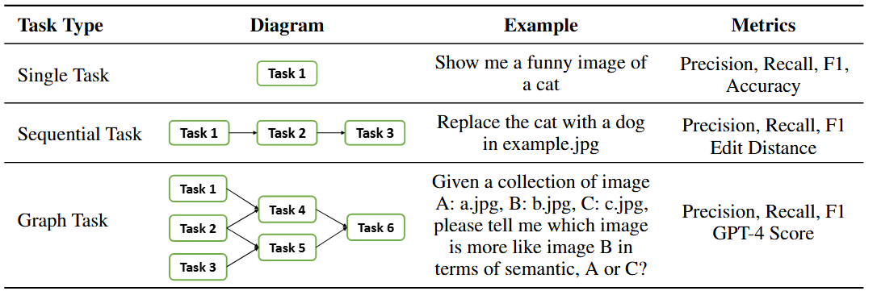
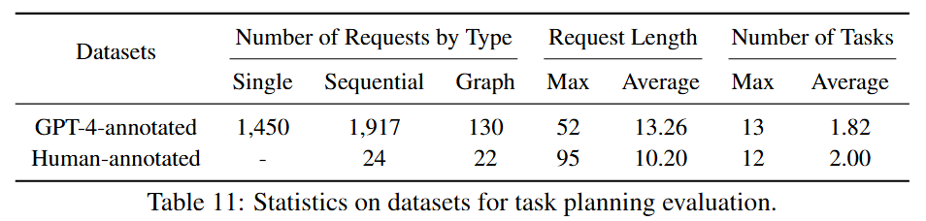
Datasets

Slide 9
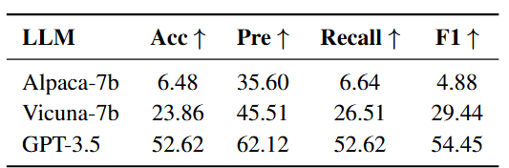
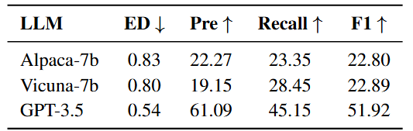
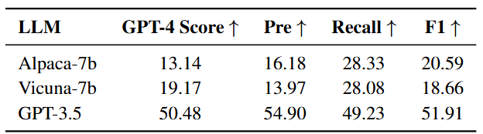
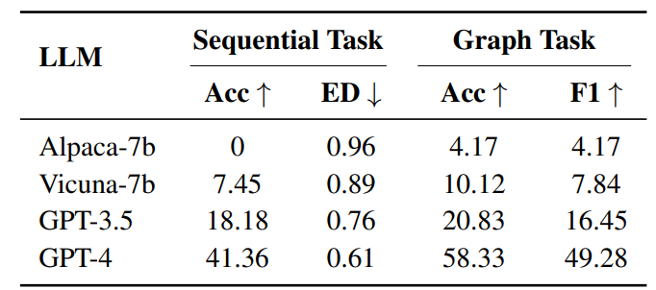
Experiments
Single
Sequential Task
Graph Task
GPT4 annotated
Human annotated

Slide 10
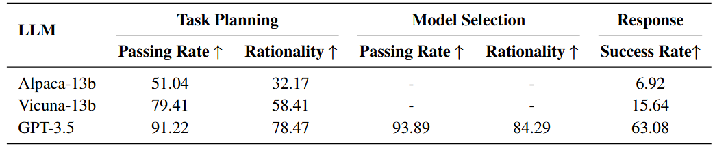
Experiments
Passing rate: to determine whether the planned task graph or selected model can be successfully executed.
Rationality : to access whether the generated task sequence or selected tools align with user requests in a rational manner.
Success Rate : to verify if the final results satisfy the user’s request.

Slide 11
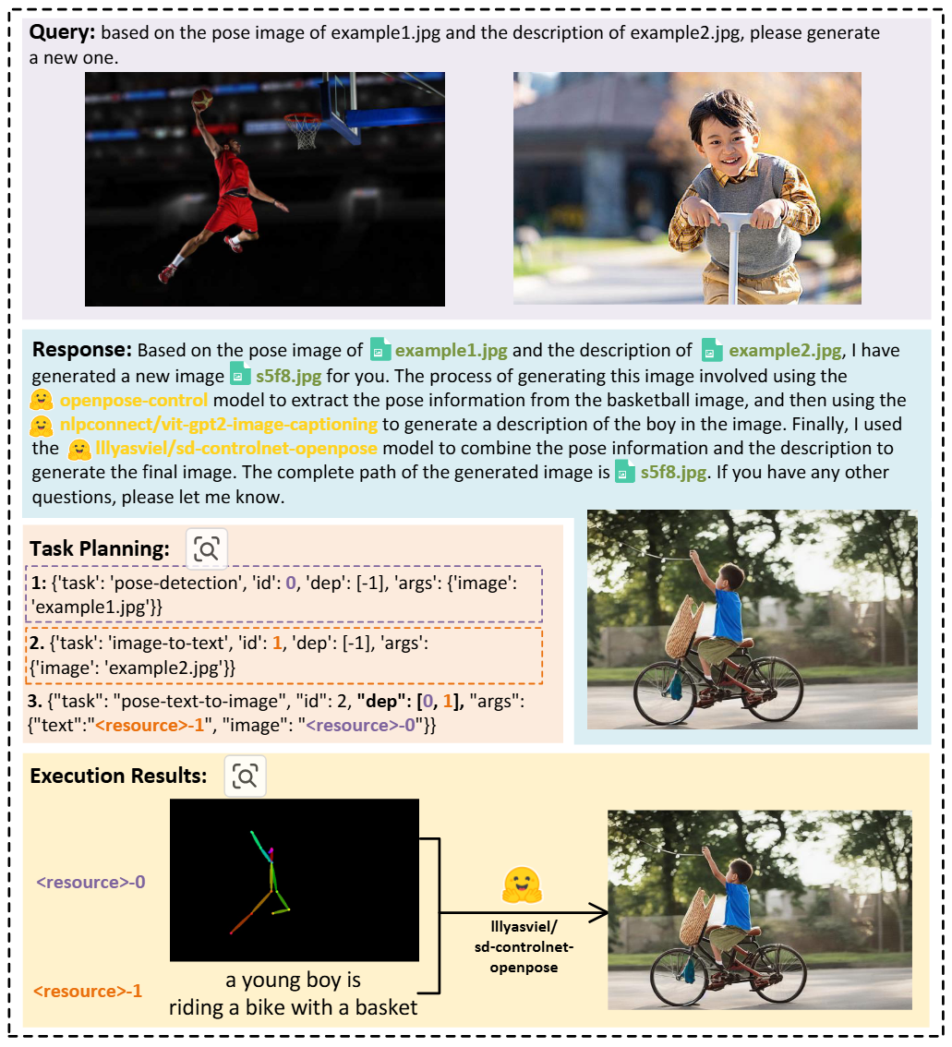
Results

Slide 12
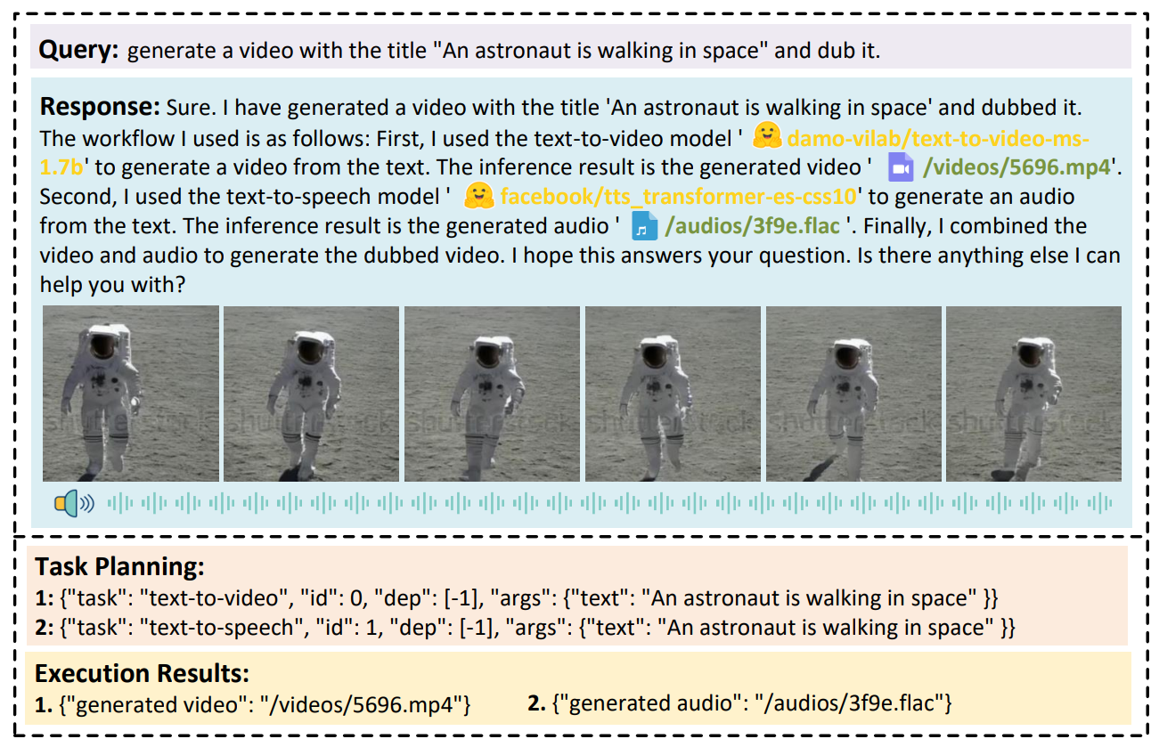
Results

